Slide 1
Capstone Project – 1 EDA Play Store App Review Analysis
Team Members - Avinash Yadav Deepika Yadav

Slide 2
DISCUSSION OF GOOGLE PLAY STORE DATASET WILL INVOLVE VARIOUS STEPS SUCH AS: -> Problem Statement -> Goal of the Project -> Introduction to Data -> Data Summary -> Data Pipelining -> extracting statistics from the dataset -> exploratory analysis and visualizations -> questions that can be asked from the dataset -> conclusion -> Challenges -> Q & A

Slide 3
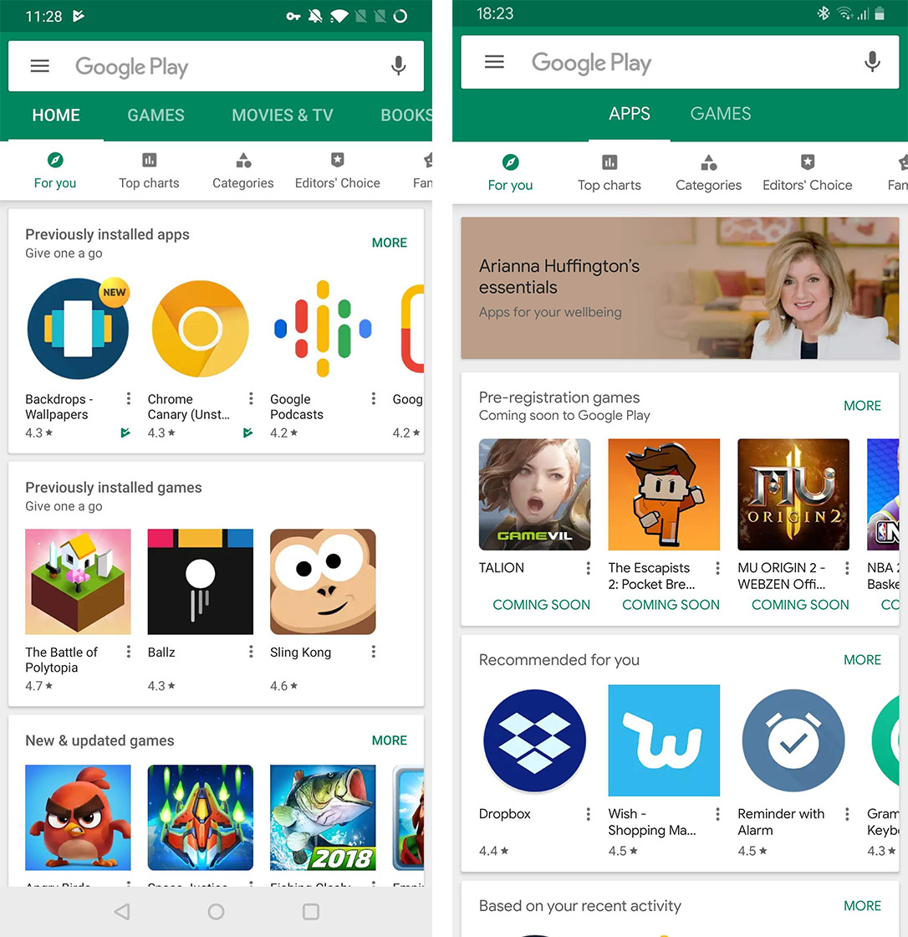

PROBLEM STATEMENT Android is expanding as an operating system. It has captured around 74% of the total market which is a true indicator of the huge amount of population using android. Our goal is to help android developers to know what is the motivating factor for people to download an app. It will also help to find out the factors that affect someone’s decision to download an app. We would like to analyse category, reviews, price, ratings and installs for this purpose and find out how they are inter related.

Slide 4
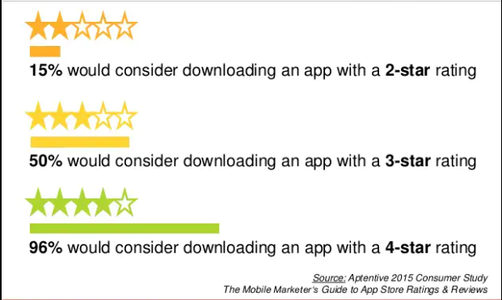
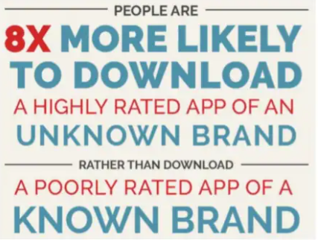
GOAL OF THE PROJECT With around three million apps available on Google Play Store, developing apps that stand out amongst the competition poses a challenge for app developers. To differentiate themselves in this oversaturated market, they need to pinpoint essential factors that play a role in customers’ decision-making process. The objective of this project is to deliver insights to understand customer demands better and thus help developers to popularize the product. To clarify, the ‘popular’ in this project means a high number of installations.

Slide 5
INTRODUCTION TO DATA Firstly let's get to know data. While we were analyzing the data, we used Pandas library. -> info(): It informs about data columns and data types. -> head(): It returns the first five data. -> tail(): It returns the last five data. -> columns : It returns data columns -> shape : It gives number of rows and columns in a tuple.

Slide 6
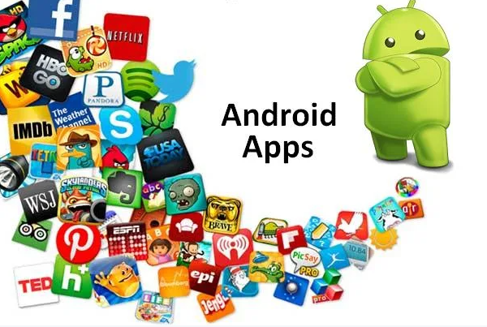
DATA SUMMARY The dataset contains details of Android applications present on Google Play Store. For analysis of the mentioned data, three we have used Python. Our business case is to locate the best Apps, which we measure by Review check. There are 13 includes that depict each application and an aggregate of 10842 applications. Following variables were initially included: 1. App – Name of the app 2. Category – Category of the app 3. Rating - Over all user rating of the app out of 5 on the Play Store 4. Size – Size of app 5. Reviews – Number of user reviews for the app 6. Installs – Number of user downloads/installs for the app 7. Type – Paid or free 8. Price – Cost of the app 9. Content Rating – Age group the app is targeted at 10. Genres - An app can belong to multiple genres (apart from its main category) 11. Last Updated - Date when the app was last updated on Play Store 12. Current Ver. - Current version of the app available on Play Store 13. Android Ver. – Minimum required android version

Slide 7
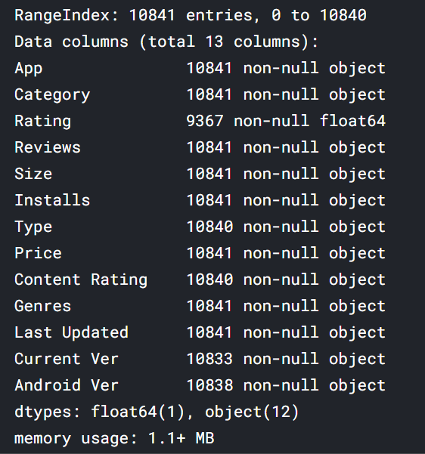
DATA PIPELINE 1. DATA PREPARATION It has information such as app name, category, rating, and more. And the other is a list of reviews for each app with the sentiment if that particular content of the review was positive, neutral, or negative. Data preparation is the process of cleaning and transforming raw data prior to processing and analysis. It is an important step prior to processing and often involves reformatting data, making corrections to data and the combining of data sets to enrich data. 2. GATHERING DATA This step is about getting to know the data and understanding what has to be done before the data becomes useful in a particular context. This can be done by reading the CSV file and doing initial statistical analysis. Though the dataset may seem to have the correct data types for each column, we need to check it. Inconsistent data types will create issues while dealing with problems.

Slide 8
DATA PIPELINE(Contd…) 3. DATA CLEANING: First, we have analyzed which information column is irrelevant to the number of installs of the app. It was done by common sense. We removed size, last updated date, current version, and android version because they are not the factor that would affect the number of installs before publishing. Also, we have removed the rating and number of reviews because they are obviously associated with app installs and would not be known before publishing. Then we also trimmed our data of any out-of-place characters. 4. DATA VISUALIZATION: This can be used to get a glimpse of the distribution of the app market. This can help businesses in several ways. Apps could be targeted to a particular market. A business could analyze its approach to entering a market with more/moderate/fewer competitors. If the app holds a feature that may change the future usage of users, a data-driven business venture could launch the app in the market of more competitors to get a better hold of the market relying on that key feature and making further development.

Slide 9
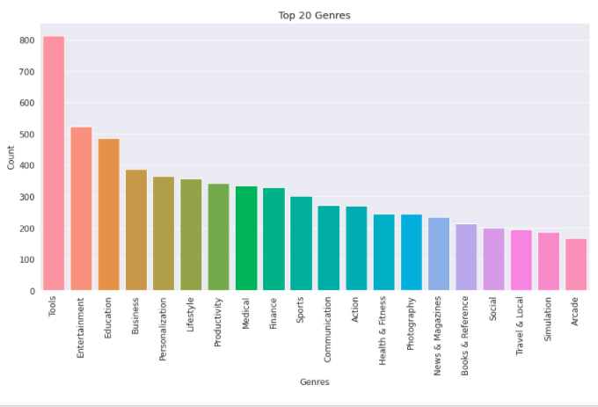
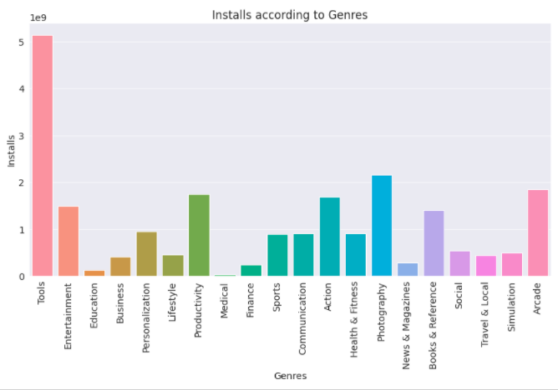
EDA ->Top 20 apps present in the ->Genres that are getting installed Google play store as per their Genres. most in top 20 Genres.

Slide 10
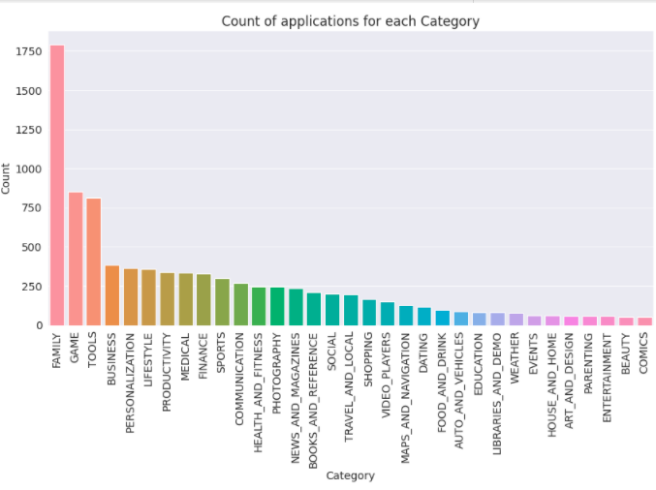
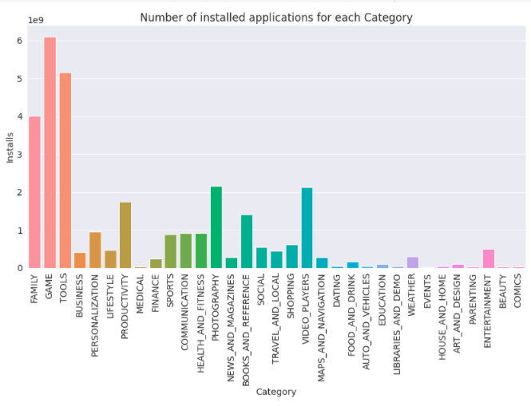
EDA(Contd…) -> Top 20 Categories base on count of apps ->Top 20 applications based on category

Slide 11
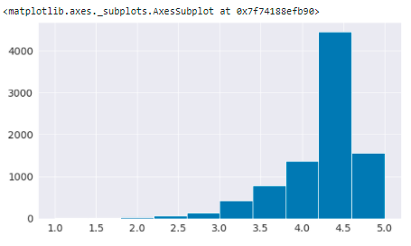
EDA(Contd…) -> average Rating of apps on play store -> According to the graph the average rating of apps on play store is 4.18

Slide 12
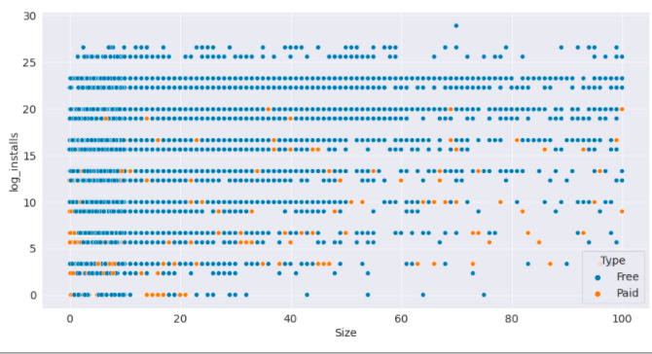
EDA(Contd…) Q. How does size impact on the number of installs of any application? -> Size of the applications present in the dataset are in MB and KB. It is clear from the above mentioned plot that size may impact the number of installations. Bulky applications are less installed by the user and this applies for both type of apps paid and free.

Slide 13
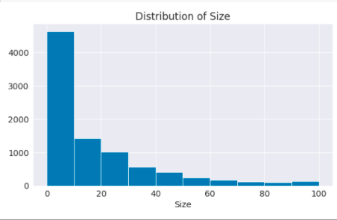
EDA(Contd…) -> size of apps: -> From the histogram, it can be concluded that maximum number of applications present in the dataset are of small size. 0 to 10 MB.

Slide 14
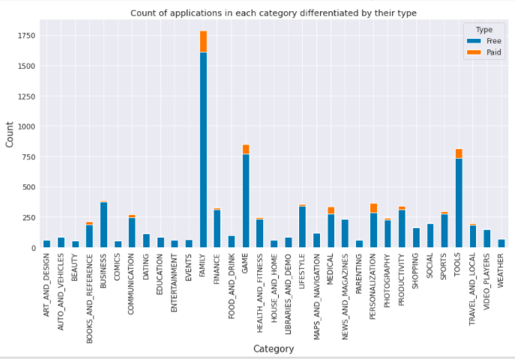
EDA(Contd…) -> The count of applications in each category differentiated by their type: -> Top 3 category of paid apps and free apps are same Family, Tools and game.

Slide 15
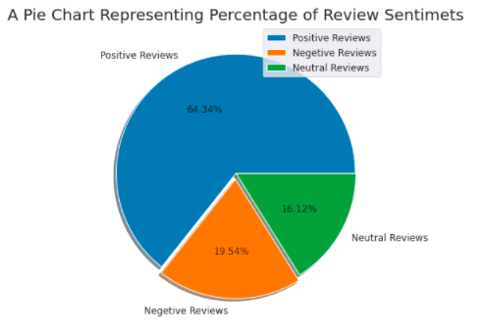
EDA(Contd…) -> Overall users review Sentiments are 64% Positive 20% Negative and 16% Neutral.

Slide 16
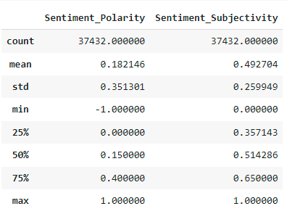
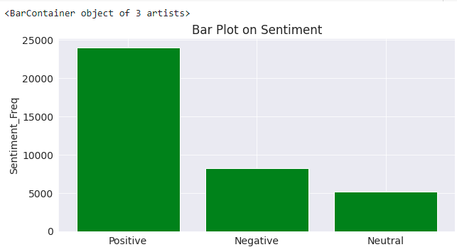
USER REVIEWS: -> About 75 percentile of the time sentiment polarity is around 0.4, which is positive. -> Subjectivity is between 0 and 1, median subjectivity that was understood was 0.51.

Slide 17
ANALYSIS SUMMARY: -> Percentage of free apps: ~92% -> Most Competitive category: Family -> Category with the highest number of installs: Game -> Category with the highest average app installs: Communication -> Percentage of apps that are top rated: ~80% -> There are 20 free apps that have been installed over a billion times. -> The median size of the apps in the play store is 12 MB.

Slide 18
CONCLUSION AND FUTURE WORK: -> The dataset contains possibilities to deliver insights to understand customer demands better and thus help developers to popularize the product. Dataset can also be used to look whether the original ratings of the app matches the predicted rating to know whether the app is performing better or worse compared to other apps on the Play Store. It is not limited to the problem taken into consideration for this project. Many other interesting possibilities can be explored using this dataset. Future Work: -> Prediction of the number of reviews and installs by using the regression model. -> Identifying the categories and stats of the most installed apps. -> Exploring the correlation between the size of the app, the version of Android, etc on the number of installs.

Slide 19
CHALLENGES: -> The data was huge and was to be handles keeping in mind that we do not miss anything which is even of a little relevance. -> Designing multiple visualizations to summarize the information in the dataset and successfully communicate the results and trends to the reader. -> Computation time.

Slide 20

THANK YOU Q & A

